Slide 1

Welcome To My Presentation

Slide 2
“Blue Eye”
MD. Nayim Islam
ID: 193313007
Semester: 8th
Section: A (Evening)
Project Supervisor:
Al Muktadir Munam
Lecturer
Dept. of CSE, VU

Slide 3
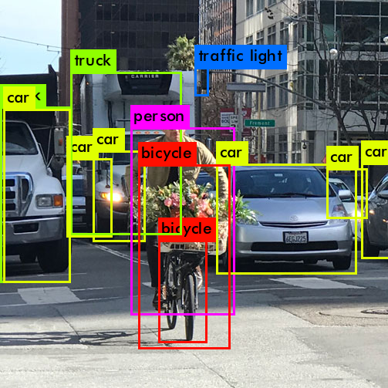
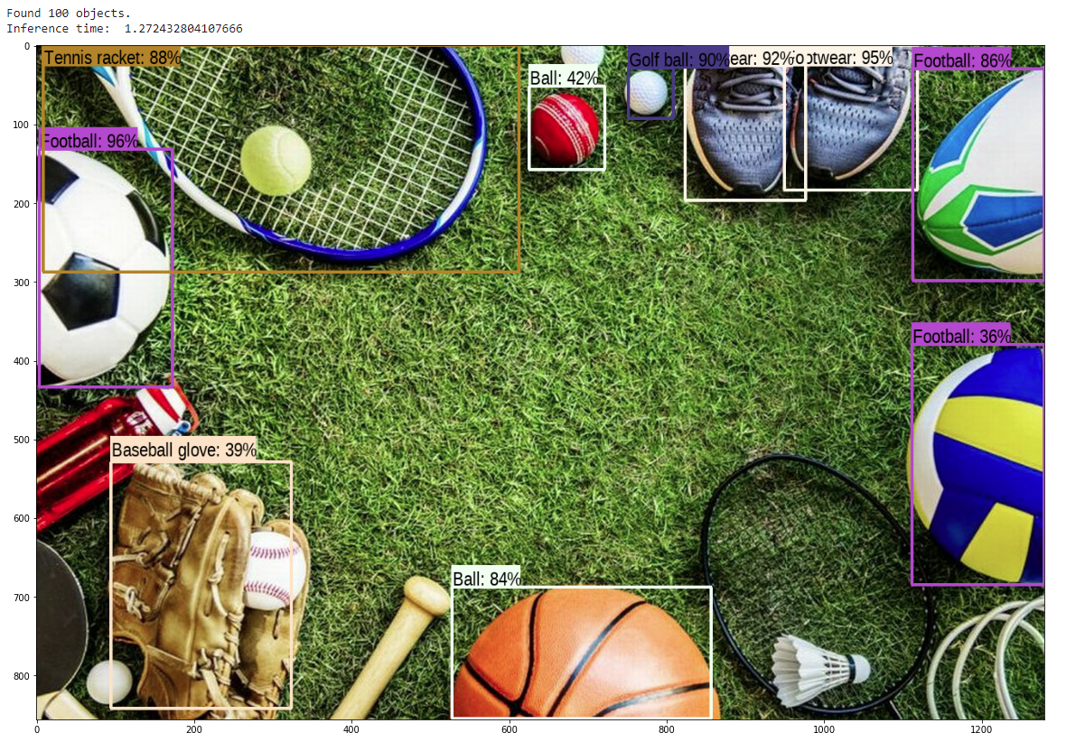
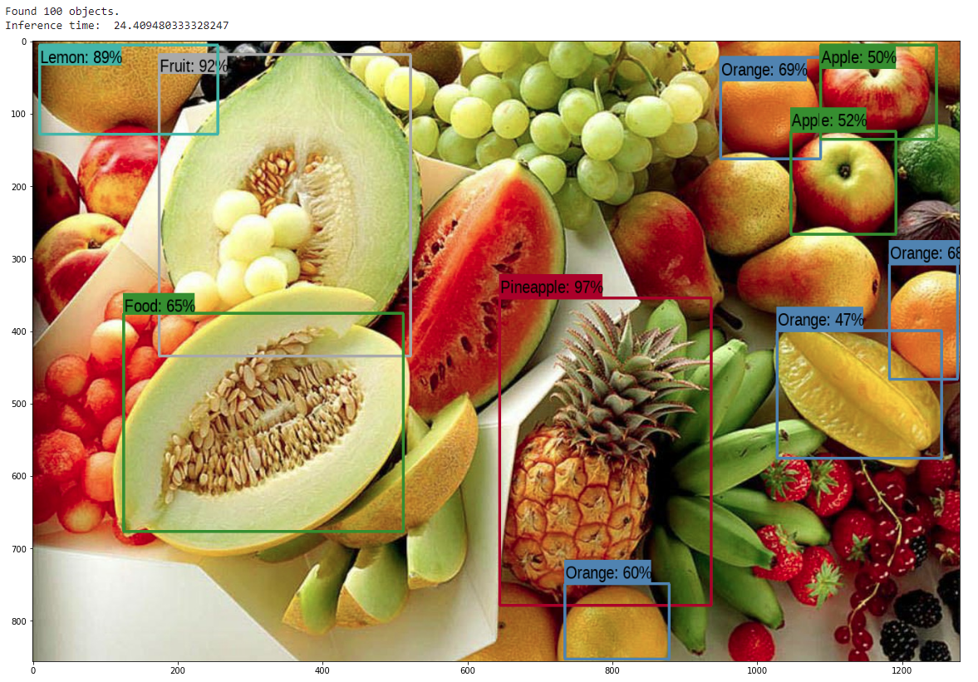
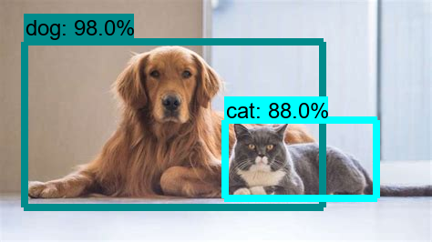
Introduction
My software will basically work like Object Detection

Slide 4


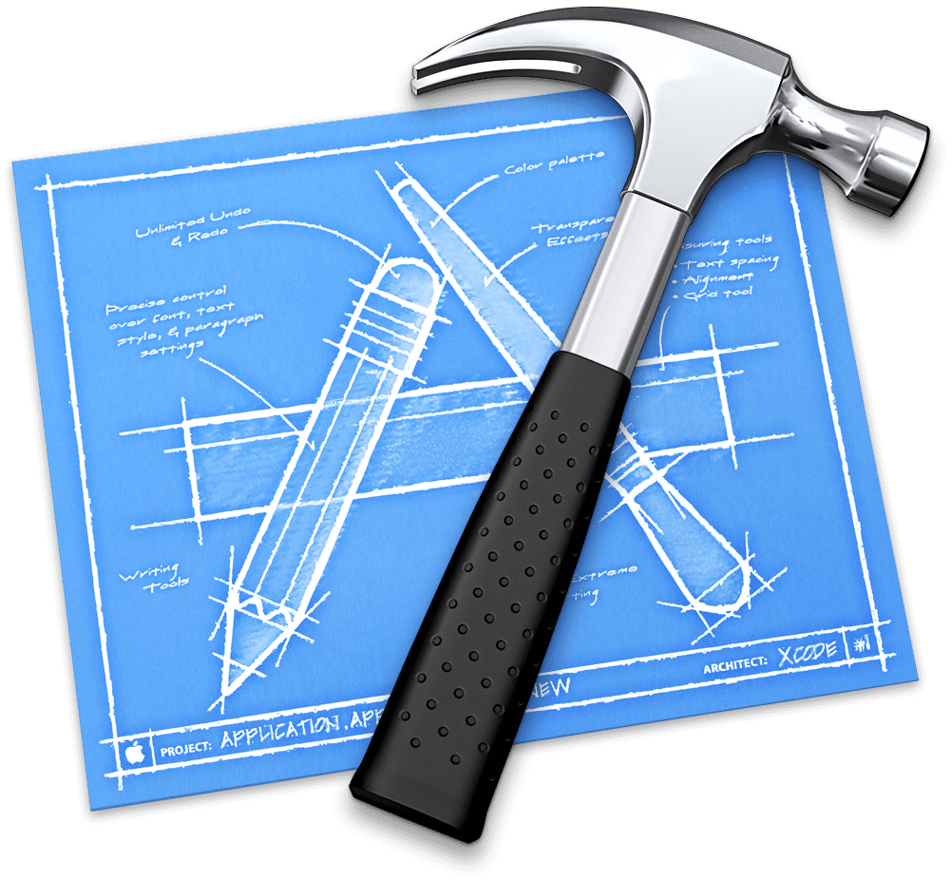



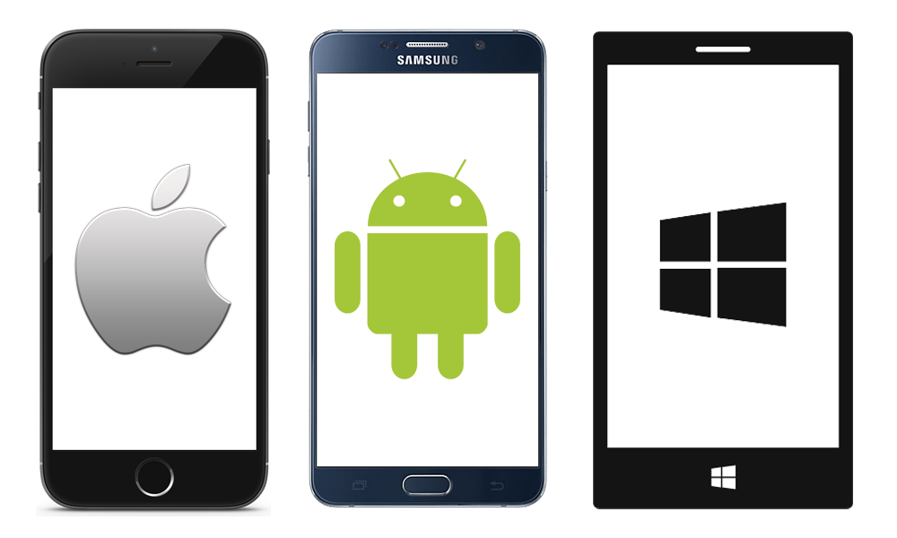





System Overview: Tools
Tools: Android Studio, VS Code, XCode.
Platform: Android, iOS, Mac, Windows, web.
Language: Dart.
Framework: Flutter
Database: Firebase, Google Cloud.
Icon Design: Adobe Illustrator CC 2021
Data Train: Teachable Machine, Dialog flow.
Emulator: Android, iOS.

Slide 5
Application Features
Object Detection by Video
Object Detection by Image
Object Detection by Pose
Voice read & speak Answer
Chatbot
All output is shown in voice & text
Users can update the Object
Users can Feedback & Rating

Slide 6
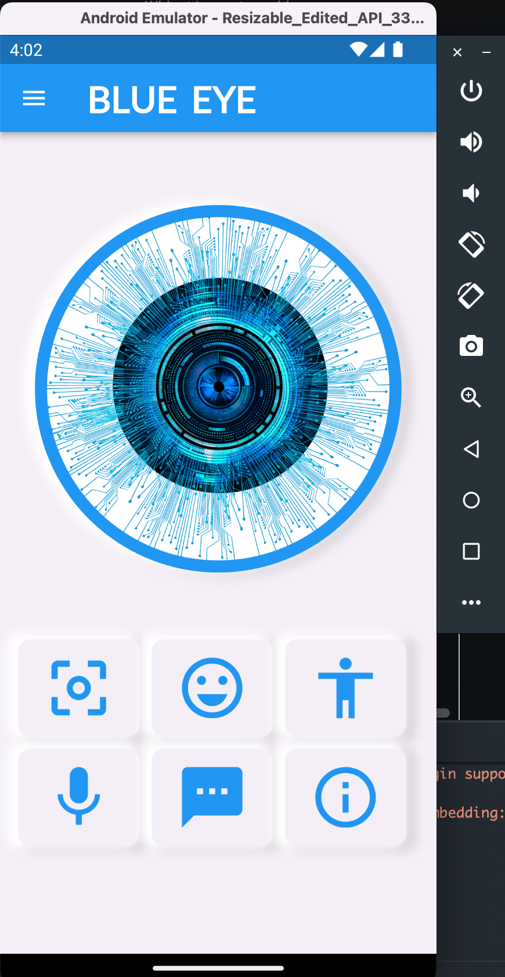
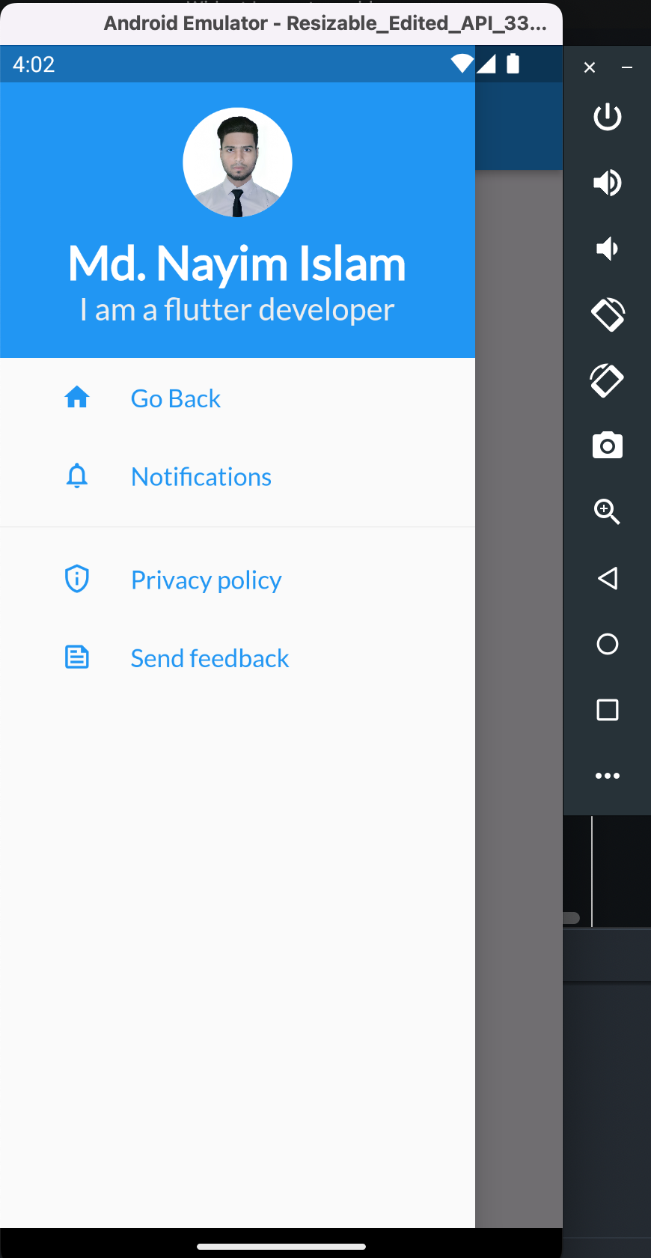
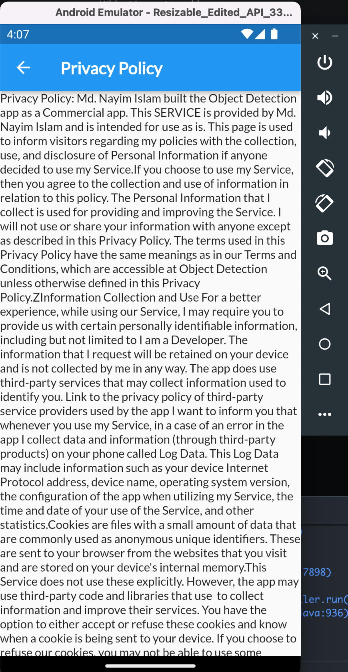
Output

Slide 7
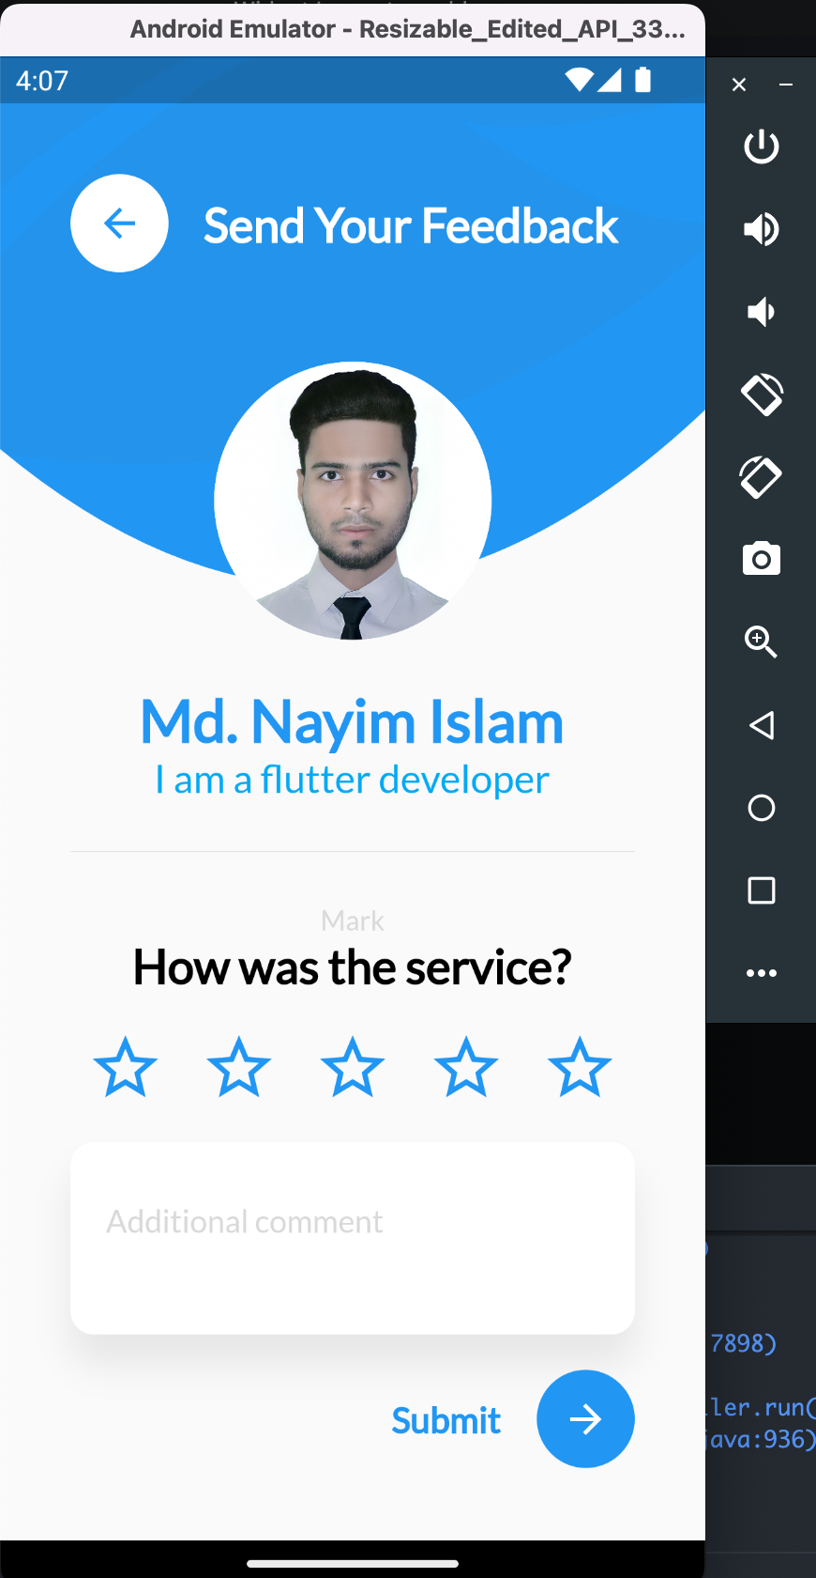
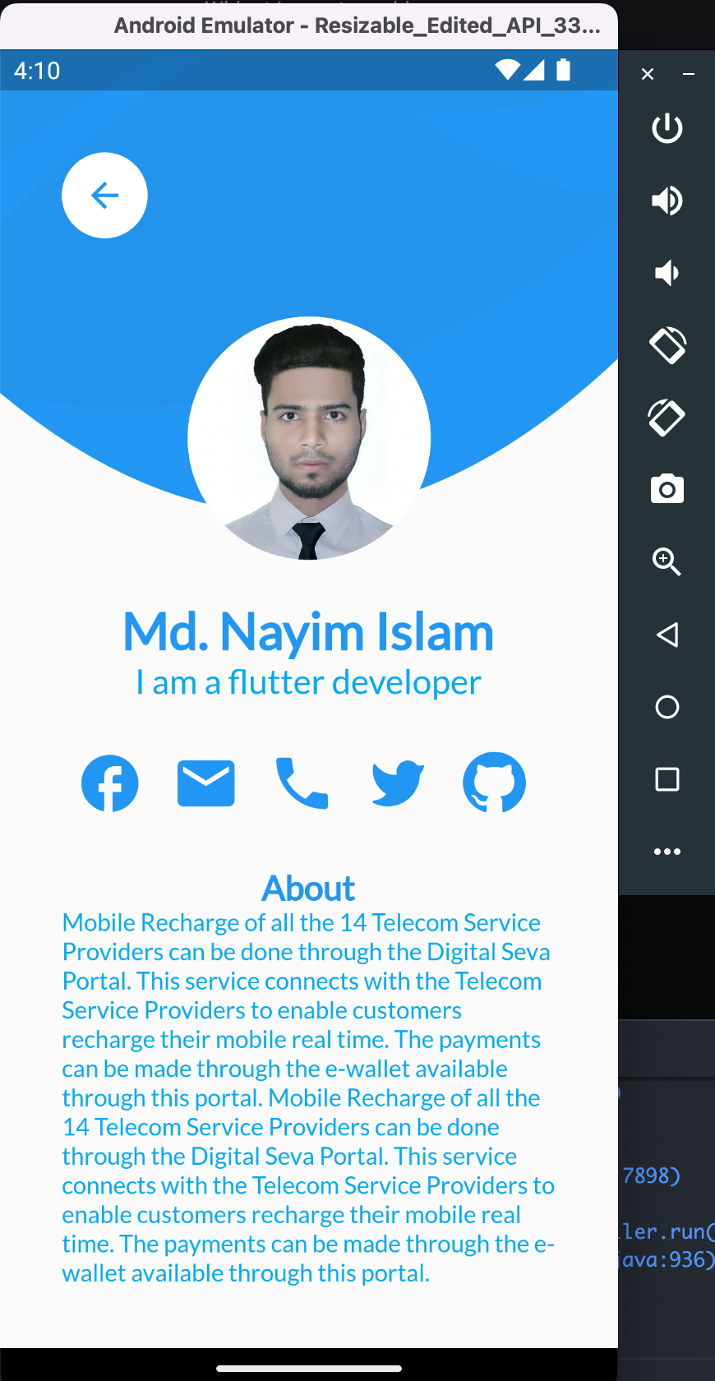
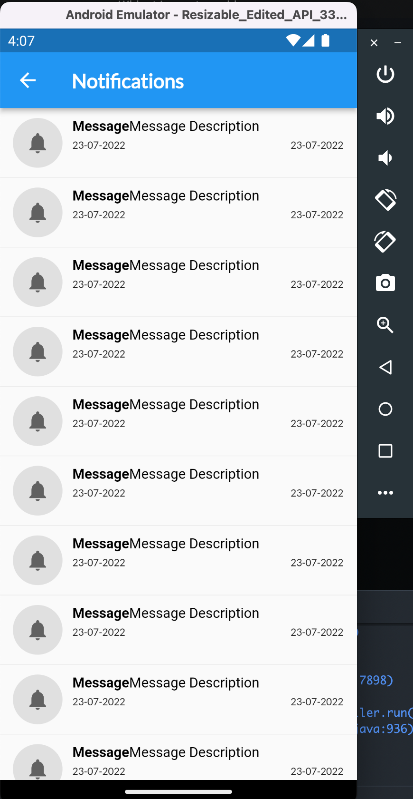
Output

Slide 8
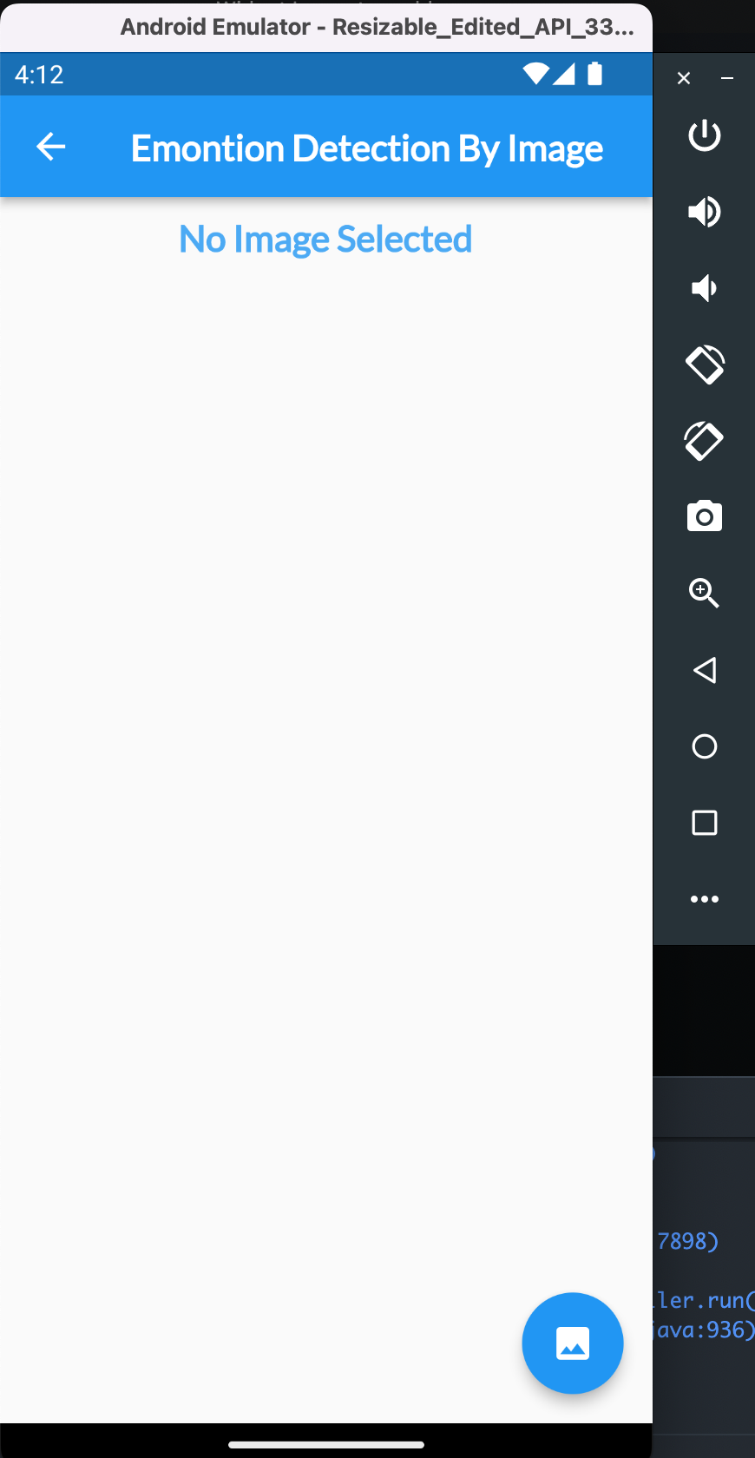
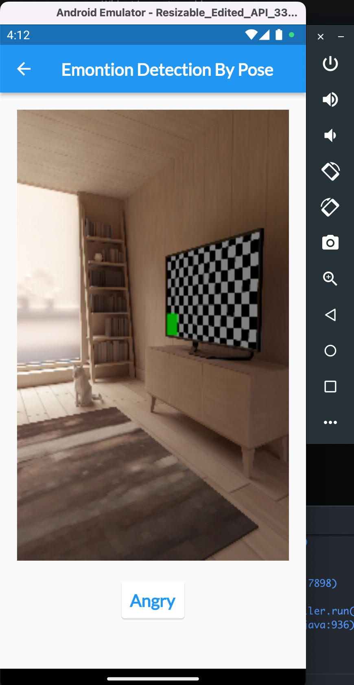
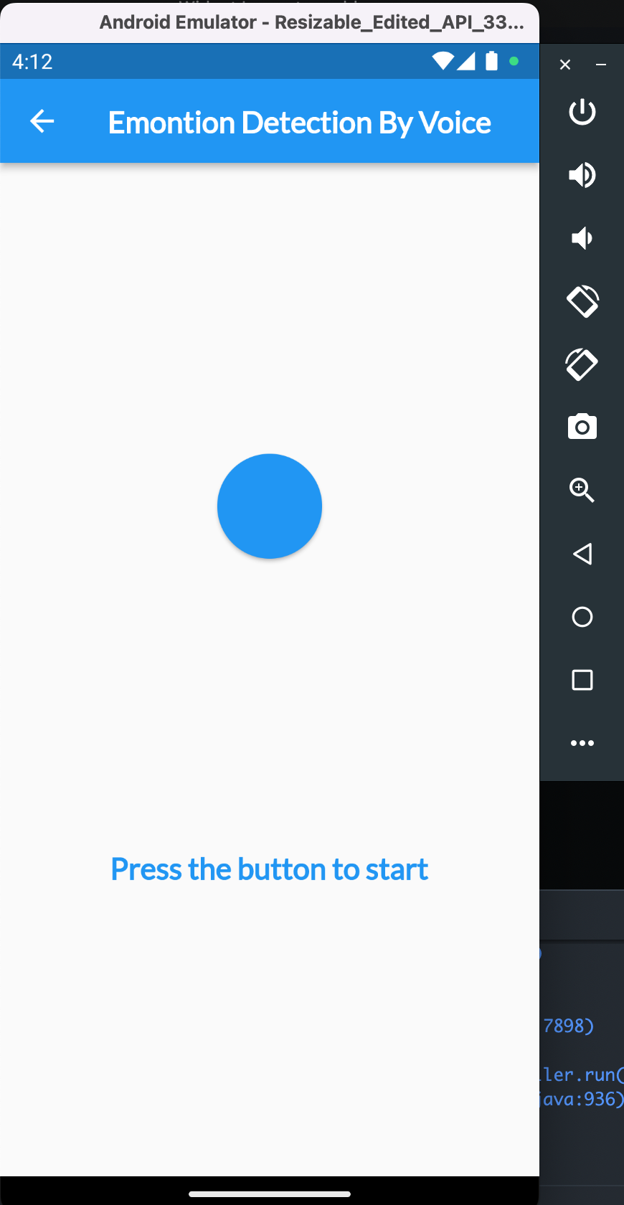
Output

Slide 9
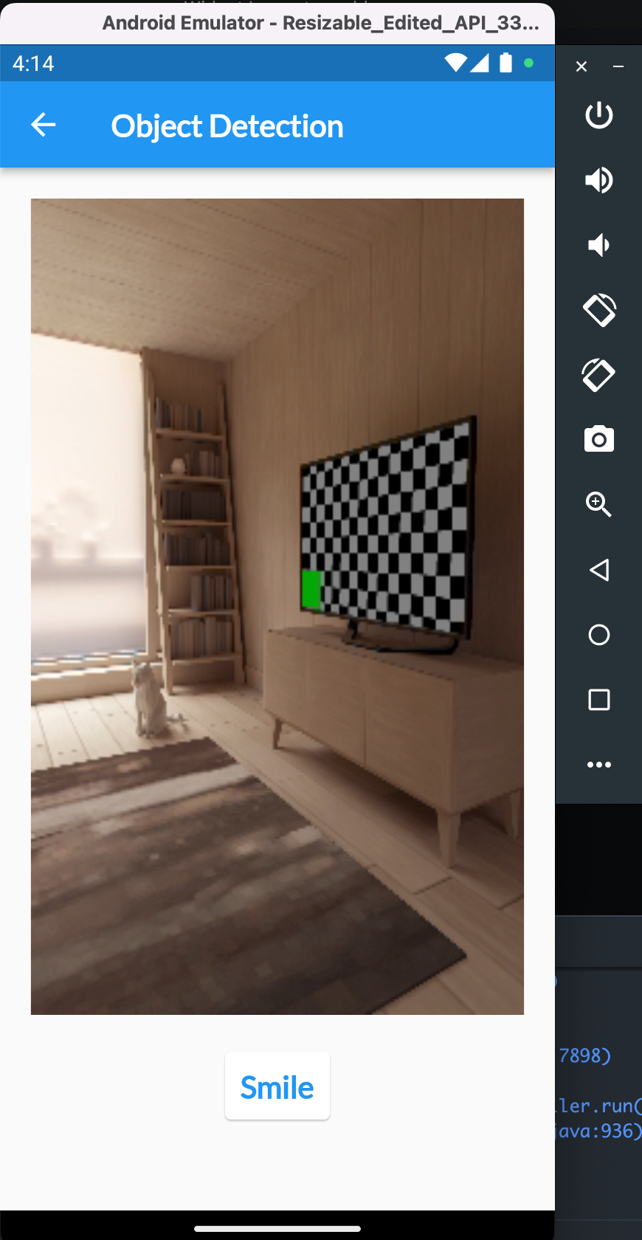
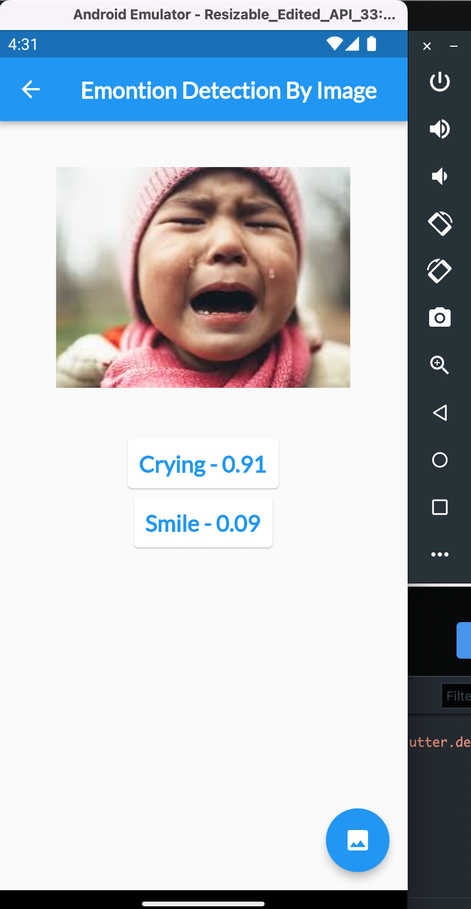
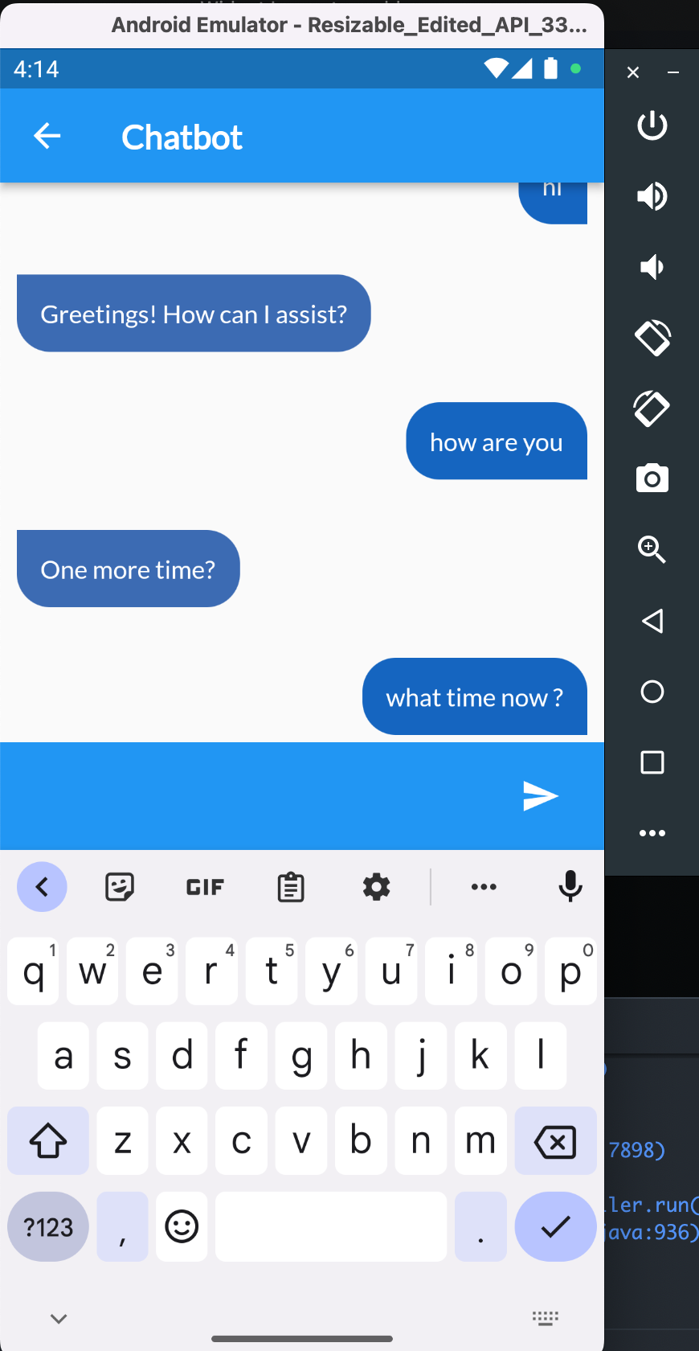
Output

Slide 10
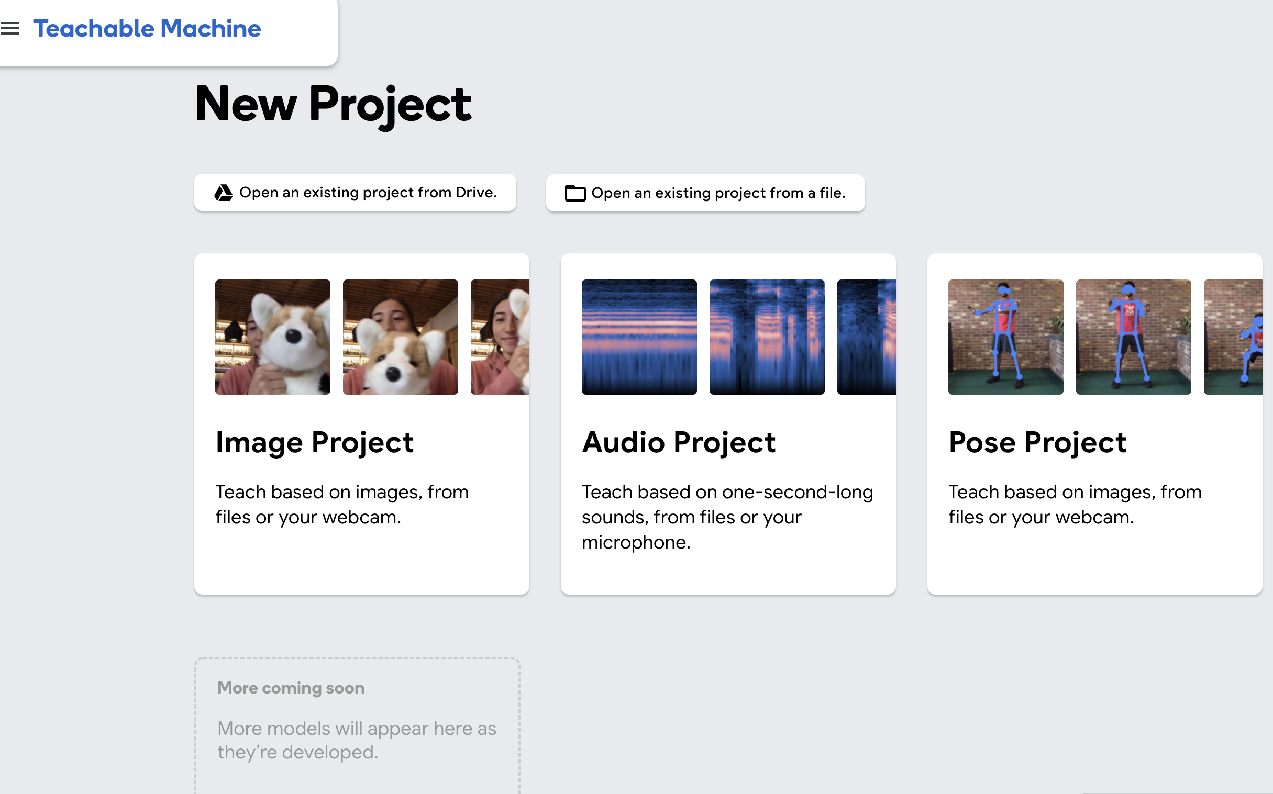
Teachable Machine

Slide 11
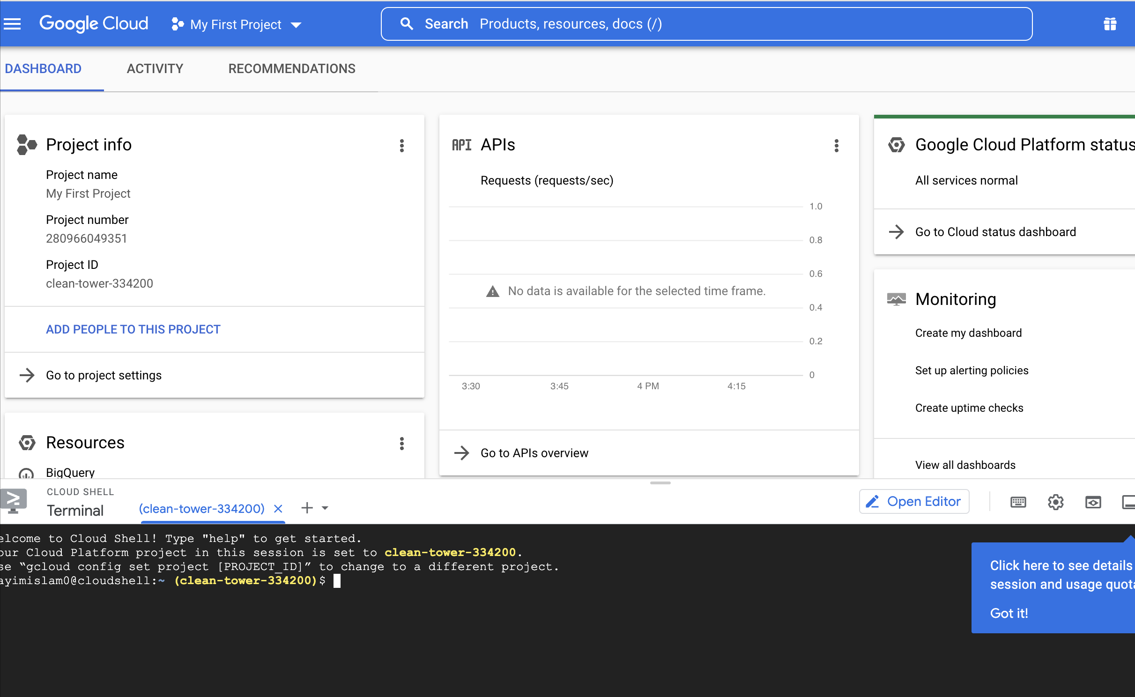
Google Cloud

Slide 12
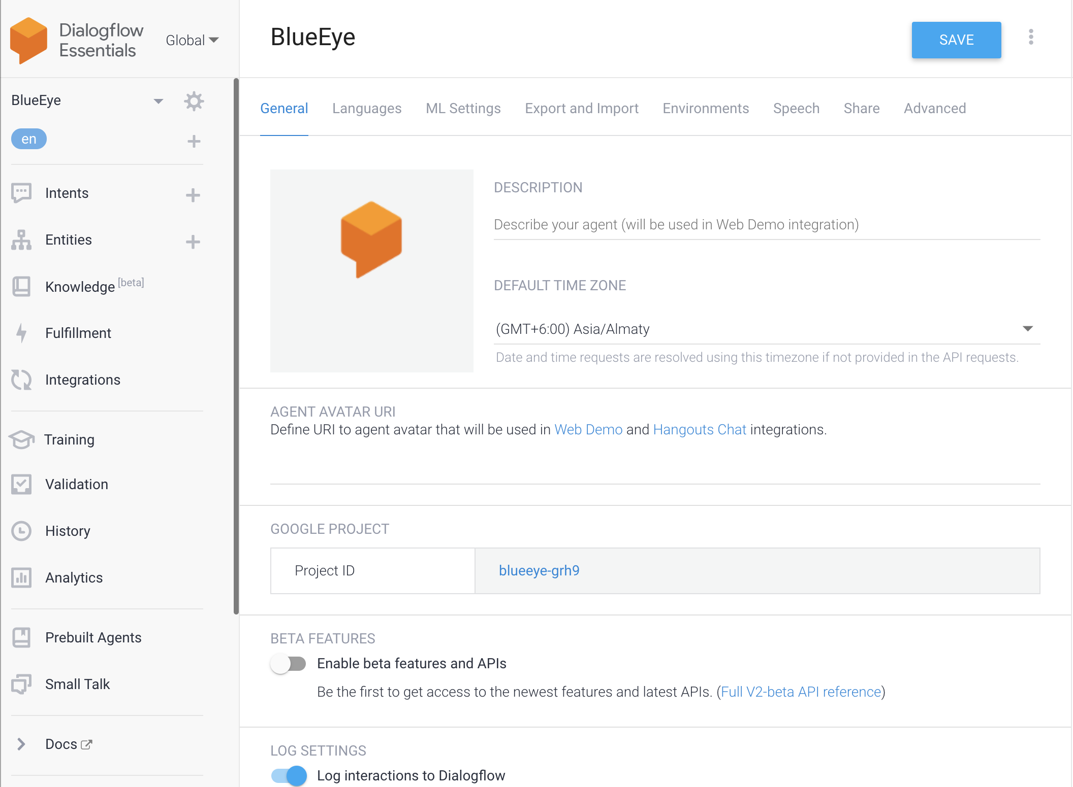
Dialog flow

Slide 13
Application Link
Project Link: https://github.com/MdNayimIslam/blue_eye
APK Link: https://drive.google.com/file/d/1sMuJJIIk5HmMwOVjnFWfgm0I-JfBw8ud/view?usp=sharing

Slide 14
THANK YOU

